Slide 1
Artificial Intelligence
Dr. Bidush Kumar Sahoo
G.I.E.T. University,
Gunupur, Odisha

Slide 2
Reasoning
The reasoning is the mental process of deriving logical conclusion and making predictions from available knowledge, facts, and beliefs. Or we can say, "Reasoning is a way to infer facts from existing data." It is a general process of thinking rationally, to find valid conclusions.
In artificial intelligence, the reasoning is essential so that the machine can also think rationally as a human brain, and can perform like a human.

Slide 3
Symbolic Reasoning
➢ The reasoning is the act of deriving a conclusion from certain properties using a given methodology.
➢ The reasoning is a process of thinking; reasoning is logically arguing; reasoning is drawing the inference.
➢ When a system is required to do something, that it has not been explicitly told how to do, it must reason. It must figure out what it needs to know from what it already knows.
➢ Many types of Reasoning have been identified and recognized, but many questions regarding their logical and computational properties still remain controversial.
➢ The popular methods of Reasoning include abduction, induction, model-based, explanation and confirmation. All of them are intimately related to problems of belief revision and theory development, knowledge absorption, discovery, and learning.

Slide 4
Logical Reasoning
➢ Logic is a language for reasoning. It is a collection of rules called Logic arguments, we use when doing logical reasoning.
➢ The logic reasoning is the process of drawing conclusions from premises using rules of inference.
➢ The study of logic divided into formal and informal logic. The formal logic is sometimes called symbolic logic.
➢ Symbolic logic is the study of symbolic abstractions (construct) that capture the formal features of logical inference by a formal system.
➢ The formal system consists of two components, a formal language plus a set of inference rules.
➢ The formal system has axioms. Axiom is a sentence that is always true within the system.
➢ Sentences derived using the system’s axioms and rules of derivation called theorems.

Slide 5
Monotonic Reasoning
In monotonic reasoning, once the conclusion is taken, then it will remain the same even if we add some other information to existing information in our knowledge base. In monotonic reasoning, adding knowledge does not decrease the set of prepositions that can be derived.
To solve monotonic problems, we can derive the valid conclusion from the available facts only, and it will not be affected by new facts.
Monotonic reasoning is not useful for the real-time systems, as in real time, facts get changed, so we cannot use monotonic reasoning.
Monotonic reasoning is used in conventional reasoning systems, and a logic-based system is monotonic. Any theorem proving is an example of monotonic reasoning.
Example:
Earth revolves around the Sun.
It is a true fact, and it cannot be changed even if we add another sentence in knowledge base like, "The moon revolves around the earth" Or "Earth is not round," etc.
Advantages of Monotonic Reasoning:
➢ In monotonic reasoning, each old proof will always remain valid.
➢ If we deduce some facts from available facts, then it will remain valid for always.
Disadvantages of Monotonic Reasoning:
➢ We cannot represent the real world scenarios using Monotonic reasoning.
➢ Hypothesis knowledge cannot be expressed with monotonic reasoning, which means facts should be true.
➢ Since we can only derive conclusions from the old proofs, so new knowledge from the real world cannot be added. ➢ Penguins cannot fly

Slide 6
Non-monotonic Reasoning
In Non-monotonic reasoning, some conclusions may be invalidated if we add some more information to our knowledge base.
Logic will be said as non-monotonic if some conclusions can be invalidated by adding more knowledge into our knowledge base.
Non-monotonic reasoning deals with incomplete and uncertain models.
"Human perceptions for various things in daily life, "is a general example of non-monotonic reasoning.
Example: Let suppose the knowledge base contains the following knowledge:
➢ Birds can fly
➢ Pitty is a bird
So from the above sentences, we can conclude that Pitty can fly.

Slide 7
Default Reasoning
Default reasoning can express facts like ―by default, something is true‖; by contrast, standard logic can only express that something is true or that something is false. This is a problem because reasoning often involves facts that are true in the majority of cases but not always. A classical example is: ―birds typically fly‖. This rule can be expressed in standard logic either by ―all birds fly‖, which is inconsistent with the fact that penguins do not fly, or by ―all birds that are not penguins and not ostriches and ... fly‖, which requires all exceptions to the rule to be specified. Default logic aims at formalizing inference rules like this one without explicitly mentioning all their exceptions.

Slide 8
Deductive reasoning
Deductive reasoning is deducing new information from logically related known information. It is the form of valid reasoning, which means the argument's conclusion must be true when the premises are true.
Deductive reasoning is a type of propositional logic in AI, and it requires various rules and facts. It is sometimes referred to as top-down reasoning, and contradictory to inductive reasoning.
In deductive reasoning, the truth of the premises guarantees the truth of the conclusion.
Deductive reasoning mostly starts from the general premises to the specific conclusion, which can be explained as below example.
Example:
Premise-1: All the human eats veggies Premise-2: Suresh is human. Conclusion: Suresh eats veggies.

Slide 9
Inductive Reasoning
Inductive reasoning is a form of reasoning to arrive at a conclusion using limited sets of facts by the process of generalization. It starts with the series of specific facts or data and reaches to a general statement or conclusion. Inductive reasoning is a type of propositional logic, which is also known as cause-effect reasoning or bottom- up reasoning.
In inductive reasoning, we use historical data or various premises to generate a generic rule, for which premises support the conclusion.
In inductive reasoning, premises provide probable supports to the conclusion, so the truth of premises does not guarantee the truth of the conclusion.
Example:
Premise: All of the pigeons we have seen in the zoo are white. Conclusion: Therefore, we can expect all the pigeons to be white.

Slide 10
Abductive reasoning
Abductive reasoning is a form of logical reasoning which starts with single or multiple observations then seeks to find the most likely explanation or conclusion for the observation.
Abductive reasoning is an extension of deductive reasoning, but in abductive reasoning, the premises do not guarantee the conclusion.
Example:
Implication: Cricket ground is wet if it is raining
Axiom: Cricket ground is wet. Conclusion It is raining.
Common Sense Reasoning
Common sense reasoning is an informal form of reasoning, which can be gained through experiences.
Common Sense reasoning simulates the human ability to make presumptions about events which occurs on every day. It relies on good judgment rather than exact logic and operates on heuristic knowledge and heuristic rules.
Example:
The above two statements are the examples of common sense reasoning which a human mind can easily understand and assume.
1. One person can be at one place at a time. 2. If I put my hand in a fire, then it will burn.

Slide 11
Forward & Backward Reasoning
Forward Reasoning
The solution of a problem generally includes the initial data and facts in order to arrive at the solution. These unknown facts and information is used to deduce the result.
For example, while diagnosing a patient the doctor first check the symptoms and medical condition of the body such as temperature, blood pressure, pulse, eye colour, blood, etcetera. After that, the patient symptoms are analyzed and compared against the predetermined symptoms. Then the doctor is able to provide the medicines according to the symptoms of the patient. So, when a solution employs this manner of reasoning, it is known as forward reasoning.
Backward Reasoning
The backward reasoning is inverse of forward reasoning in which goal is analyzed in order to deduce the rules, initial facts and data.
We can understand the concept by the similar example given in the above definition, where the doctor is trying to diagnose the patient with the help of the inceptive data such as symptoms. However, in this case, the patient is experiencing a problem in his body, on the basis of which the doctor is going to prove the symptoms. This kind of reasoning comes under backward reasoning.

Slide 12
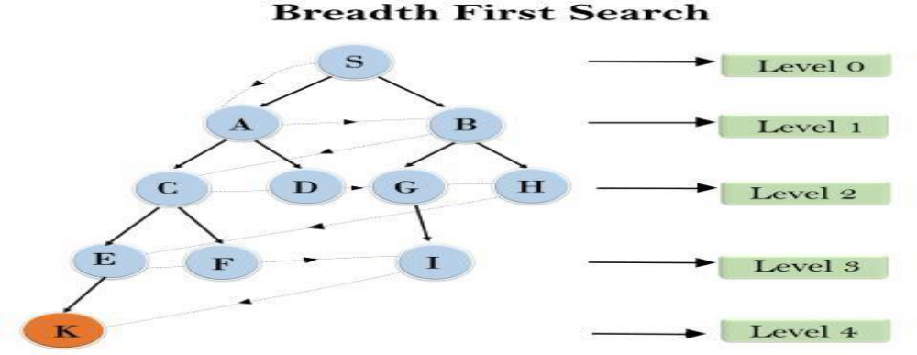
Breadth-first Search
Breadth-first search is the most common search strategy for traversing a tree or graph. This algorithm searches breadth wise in a tree or graph, so it is called breadth-first search.
BFS algorithm starts searching from the root node of the tree and expands all successor nodes at the current level before moving to nodes of next level.
The breadth-first search algorithm is an example of a general-graph search algorithm.
Breadth-first search implemented using FIFO queue data structure.
Example:
In the below tree structure, we have shown the traversing of the tree using BFS algorithm from the root node S to goal node K.
BFS search algorithm traverse in layers, so it will follow the path which is shown by the dotted arrow, and the traversed path will be:
S---> A--->B---->C--->D---->G--->H--->E---->F---->I >K

Slide 13
Time Complexity: Time Complexity of BFS algorithm can be obtained by the number of nodes traversed in BFS until the shallowest Node. Where the d= depth of shallowest solution and b is a node at every state.
T (b) = 1+b2+b3+ + bd= O (bd)
Space Complexity: Space complexity of BFS algorithm is given by the Memory size of frontier which is O(bd).
Completeness: BFS is complete, which means if the shallowest goal node is at some finite depth, then BFS will find a solution.
Optimality: BFS is optimal if path cost is a non- decreasing function of the depth of the node.
Advantages:
BFS will provide a solution if any solution exists.
If there are more than one solutions for a given problem, then BFS will provide the minimal solution which requires the least number of steps.
Disadvantages:
It requires lots of memory since each level of the tree must be saved into memory to expand the next level.
BFS needs lots of time if the solution is far away from the root node.

Slide 14
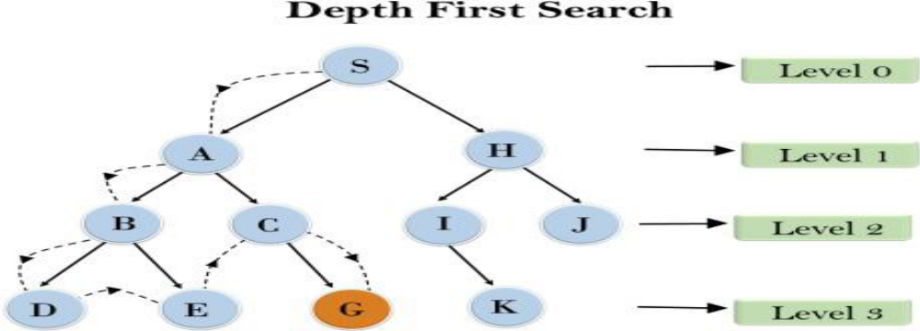
Depth-first Search
Depth-first search is a recursive algorithm for traversing a tree or graph data structure.
It is called the depth-first search because it starts from the root node and follows each path to its greatest depth node before moving to the next path.
DFS uses a stack data structure for its implementation.
The process of the DFS algorithm is similar to the BFS algorithm.
Note: Backtracking is an algorithm technique for finding all possible solutions using recursion.
Example:
In the below search tree, we have shown the flow of depth-first search, and it will follow the order as: Root node--->Left node ----> right node.
It will start searching from root node S, and traverse A, then B, then D and E, after traversing E, it will backtrack the tree as E has no other successor and still goal node is not found. After backtracking it will traverse node C and then G, and here it will terminate as it found goal node.

Slide 15
Completeness: DFS search algorithm is complete within finite state space as it will expand every node within a limited search tree.
Time Complexity: Time complexity of DFS will be equivalent to the node traversed by the algorithm. It is given by:
T(n)= 1+ n2+ n3 + + nm=O(nm)
Where, m= maximum depth of any node and this can be much larger than d (Shallowest solution depth)
Space Complexity: DFS algorithm needs to store only single path from the root node, hence space complexity of DFS is equivalent to the size of the fringe set, which is O(bm).
Optimal: DFS search algorithm is non-optimal, as it may generate a large number of steps or high cost to reach to the goal node.
Advantage:
DFS requires very less memory as it only needs to store a stack of the nodes on the path from root node to the current node.
It takes less time to reach to the goal node than BFS algorithm (if it traverses in the right path).
Disadvantage:
There is the possibility that many states keep re-occurring, and there is no guarantee of finding the solution.
DFS algorithm goes for deep down searching and sometime it may go to the infinite loop.

Slide 16
Best-first Search Algorithm (Greedy Search)
Greedy best-first search algorithm always selects the path which appears best at that moment. It is the combination of depth-first search and breadth-first search algorithms. It uses the heuristic function and search. Best-first search allows us to take the advantages of both algorithms. With the help of best-first search, at each step, we can choose the most promising node. In the best first search algorithm, we expand the node which is closest to the goal node and the closest cost is estimated by heuristic function, i.e. f(n)= g(n).
Were, h(n)= estimated cost from node n to the goal.
The greedy best first algorithm is implemented by the priority queue. Best first search algorithm:
Step 1: Place the starting node into the OPEN list.
Step 2: If the OPEN list is empty, Stop and return failure.
Step 3: Remove the node n, from the OPEN list which has the lowest value of h(n), and places it in the CLOSED list.
Step 4: Expand the node n, and generate the successors of node n.
Step 5: Check each successor of node n, and find whether any node is a goal node or not. If any successor node is goal node, then return success and terminate the search, else proceed to Step 6.
Step 6: For each successor node, algorithm checks for evaluation function f(n), and then check if the node has been in either OPEN or CLOSED list. If the node has not been in both list, then add it to the OPEN list.
Step 7: Return to Step 2.

Slide 17
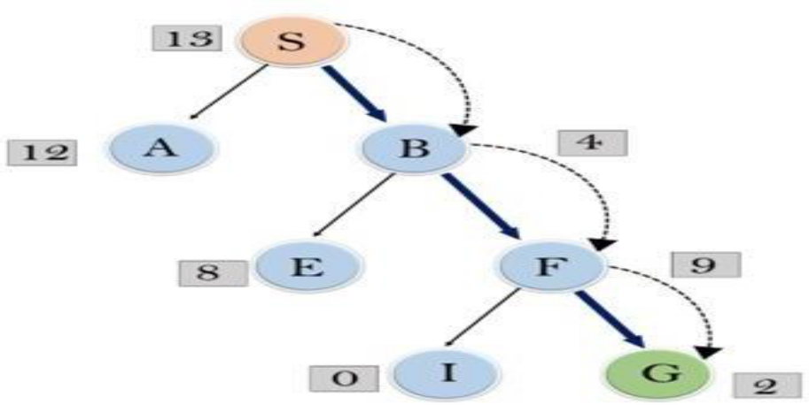
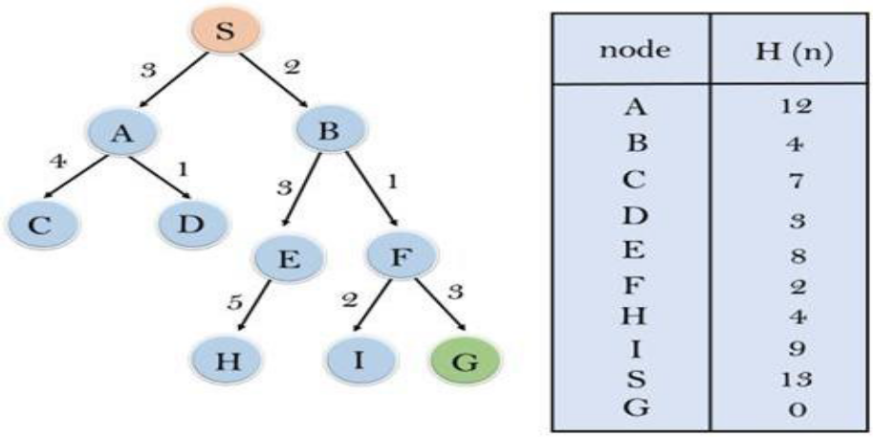
Example:
Consider the below search problem, and we will traverse it using greedy best-first search.
At each iteration, each node is expanded using evaluation function f(n)=h(n) , which is given in the below table.
Expand the nodes of S and put in the CLOSED list Initialization: Open [A, B], Closed [S]
Iteration 1: Open [A], Closed [S, B]
Iteration 2: Open [E, F, A], Closed [S, B]
: Open [E, A], Closed [S, B, F]
Iteration 3: Open [I, G, E, A], Closed [S, B, F]
: Open [I, E, A], Closed [S, B, F, G]
Hence the final solution path will be: S----> B----->F --- > G

Slide 18
Advantages:
Best first search can switch between BFS and DFS by gaining the advantages of both the algorithms.
This algorithm is more efficient than BFS and DFS algorithms.
Disadvantages:
It can behave as an unguided depth-first search in the worst case scenario.
It can get stuck in a loop as DFS.
This algorithm is not optimal.
Time Complexity: The worst case time complexity of Greedy best first search is O(bm).
Space Complexity: The worst case space complexity of Greedy best first search is O(bm). Where, m is the maximum depth of the search space.
Complete: Greedy best-first search is also incomplete, even if the given state space is finite.
Optimal: Greedy best first search algorithm is not optimal.

Slide 19
THANK YOU

